Slide 1
Recurrent Neural Networks
Spring 2018

Slide 2
Review
Last week:
Convolutional Neural Networks (CNN)
Deep Features
Assignments (Canvas):
Project proposal due yesterday
Project outline and prototype due in two weeks
Questions?

Slide 3
Today’s Topics
Machine Learning for Sequential Data
Recurrent Neural Networks (RNNs)
Vanishing/Exploding Gradients
Gated RNNs: LSTMs
Lab

Slide 4
Today’s Topics
Machine Learning for Sequential Data
Recurrent Neural Networks (RNNs)
Vanishing/Exploding Gradients
Gated RNNs: LSTMs
Lab

Slide 5
Sequence Definition: Data of Arbitrary Length
e.g., Document
e.g., Images
e.g., Images
e.g., Time-Series Data
e.g., sentences, audio samples, brain waves, radio waves, air temperature

Slide 6
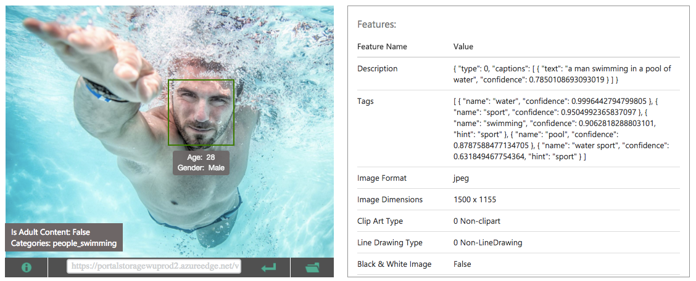
Sequence Applications: One-to-Many
Input: fixed-size
Output: sequence
e.g., image captioning
Captions: https://www.microsoft.com/cognitive-services/en-us/computer-vision-api
What are other “one-to-many” applications?

Slide 7
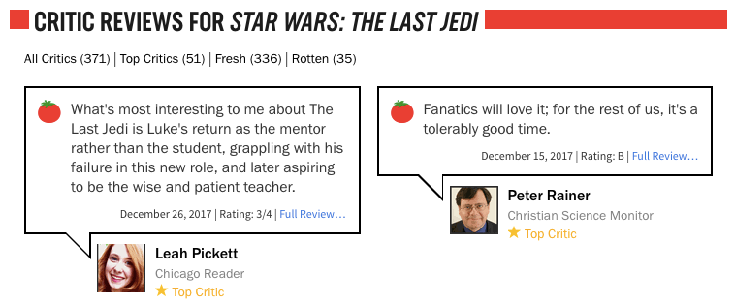
Sequence Applications: Many-to-One
Input: sequence
Output: fixed-size
e.g., sentiment analysis (hate? love?, etc)
https://www.rottentomatoes.com/m/star_wars_the_last_jedi
What are other “many-to-one” applications?

Slide 8
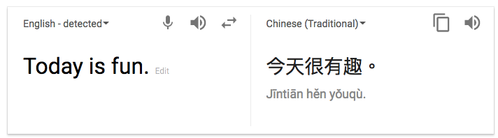
Sequence Applications: Many-to-Many
Input: sequence
Output: sequence
e.g., language translation
What are other “many-to-many” applications?

Slide 9
Today’s Topics
Machine Learning for Sequential Data
Recurrent Neural Networks (RNNs)
Vanishing/Exploding Gradients
Gated RNNs: LSTMs
Lab

Slide 10
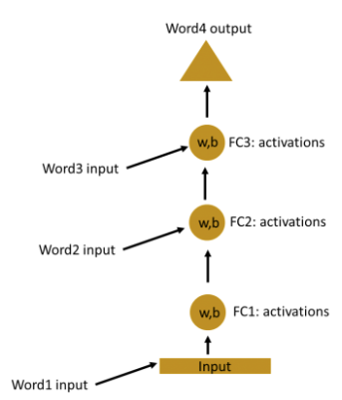
Why Recurrent Neural Networks (RNNs)?
e.g., series of words using traditional feedforward network
Problem: weights of each layer learned independently so no memory of past
Problem: many model parameters!!
https://www.analyticsvidhya.com/blog/2017/12/introduction-to-recurrent-neural-networks/

Slide 11
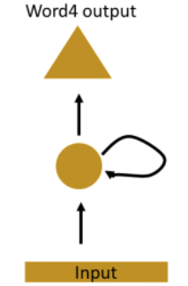
Why Recurrent Neural Networks (RNNs)?
Main idea: use hidden state to capture information about the past
Feedforward Network
Each layer receives input from the previous layer with no loops
Recurrent Network
Each layer receives input from the previous layer and the output from the previous time step
https://www.analyticsvidhya.com/blog/2017/12/introduction-to-recurrent-neural-networks/

Slide 12
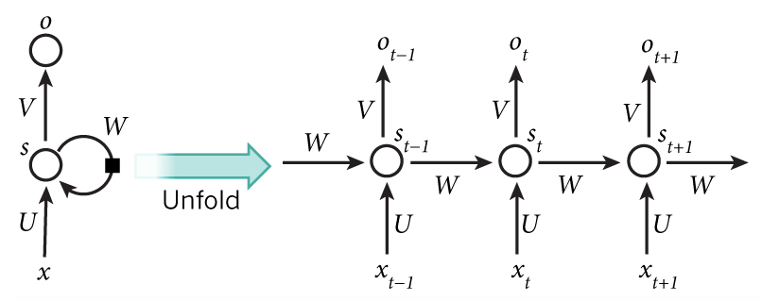
RNN
Main idea: use hidden state to capture information about the past
Paul Werbos; Backpropagation Through Time: What It Does and How to Do It; 1990
http://www.wildml.com/2015/09/recurrent-neural-networks-tutorial-part-1-introduction-to-rnns/

Slide 13
RNN: Time Step 1
Main idea: use hidden state to capture information about the past
http://www.wildml.com/2015/09/recurrent-neural-networks-tutorial-part-1-introduction-to-rnns/

Slide 14
RNN: Time Step 2
Main idea: use hidden state to capture information about the past
http://www.wildml.com/2015/09/recurrent-neural-networks-tutorial-part-1-introduction-to-rnns/

Slide 15
RNN: Time Step 3
Main idea: use hidden state to capture information about the past
http://www.wildml.com/2015/09/recurrent-neural-networks-tutorial-part-1-introduction-to-rnns/

Slide 16
RNN: And So On…
Main idea: use hidden state to capture information about the past
…
http://www.wildml.com/2015/09/recurrent-neural-networks-tutorial-part-1-introduction-to-rnns/

Slide 17
RNN: Model Parameters and Inputs
All layers share the same model parameters (U, V, W)
What is different between the layers?
…
http://www.wildml.com/2015/09/recurrent-neural-networks-tutorial-part-1-introduction-to-rnns/

Slide 18
Why Recurrent Neural Networks (RNNs)?
e.g., series of words using traditional feedforward network
Overcomes problem that weights of each layer are learned independently by using previous hidden state
Overcomes problem that model has many parameters since weights are shared across layers
Feedforward Network
Each layer receives input from the previous layer with no loops
Recurrent Network
Each layer receives input from the previous layer and the output from the previous time step
https://www.analyticsvidhya.com/blog/2017/12/introduction-to-recurrent-neural-networks/

Slide 19
Example: Predicting Sequence of Characters
Goal: predict next character in text
Training: a sequence of characters
https://www.analyticsvidhya.com/blog/2017/12/introduction-to-recurrent-neural-networks/

Slide 20
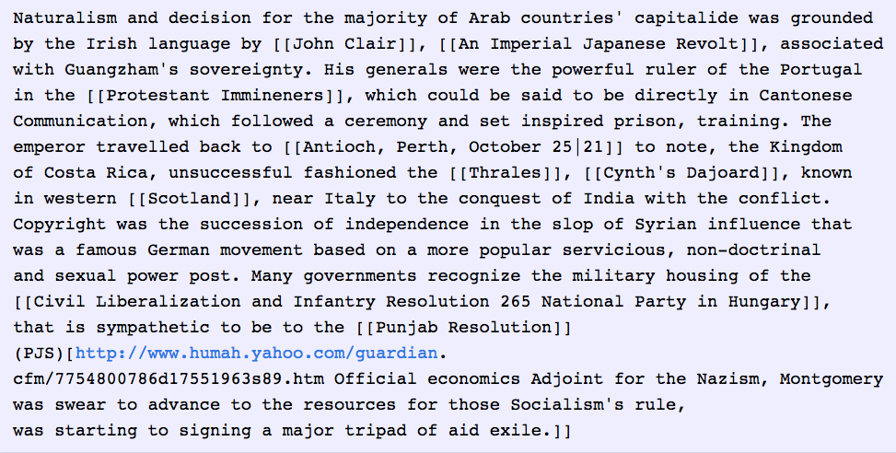
Example: Write A Wikipedia Page
Training Input
Predicted Output
http://karpathy.github.io/2015/05/21/rnn-effectiveness/

Slide 21
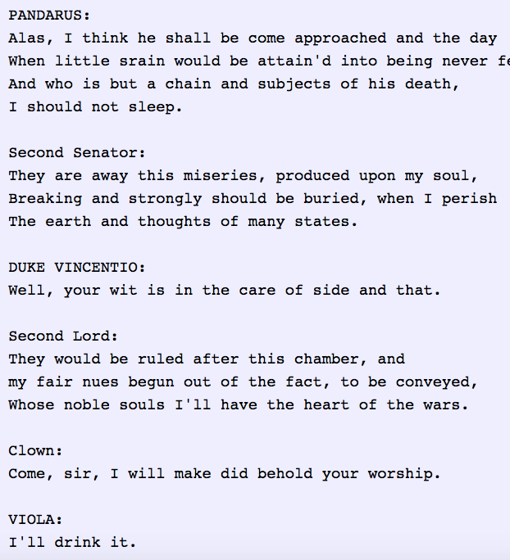
Example: Write Like Shakespeare
Training Input (All Works of Shakespeare)
Predicted Output
http://karpathy.github.io/2015/05/21/rnn-effectiveness/
https://github.com/martin-gorner/tensorflow-rnn-shakespeare

Slide 22
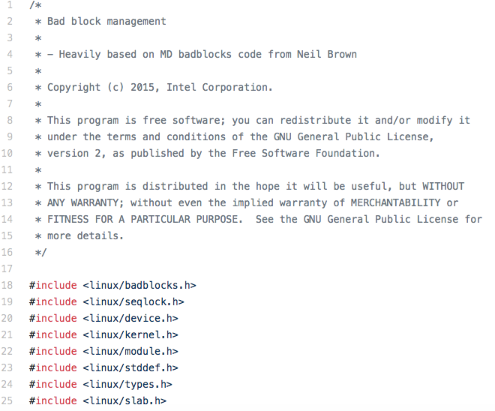
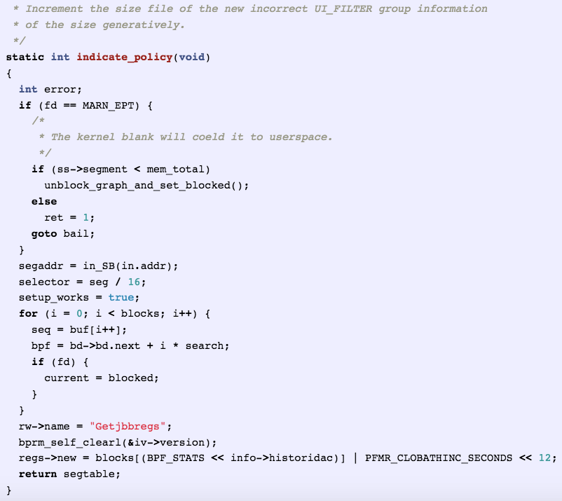
Example: Write Code
Training Input (C code on GitHub)
Predicted Output
http://karpathy.github.io/2015/05/21/rnn-effectiveness/
https://github.com/martin-gorner/tensorflow-rnn-shakespeare

Slide 23
Example: Predicting Sequence of Characters
Goal: predict next character in text
Training: feed a training sequence of characters
Applications?
Write a Wikipedia page
Write like Shakespeare
Write code in C
What are other applications that are based on predicting characters?
https://www.analyticsvidhya.com/blog/2017/12/introduction-to-recurrent-neural-networks/

Slide 24
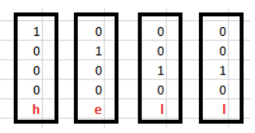
Example: Predicting Sequence of Characters
Goal: predict next character in text
Training: feed a training sequence of characters; e.g., “hello”
For simplicity, assume the following vocabulary (i.e., character set):
{h, e, l, o}
What is our input at time step 1?
What is our input at time step 2?
What is our input at time step 3?
What is our input at time step 4?
https://www.analyticsvidhya.com/blog/2017/12/introduction-to-recurrent-neural-networks/

Slide 25
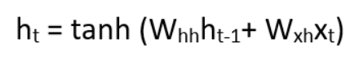
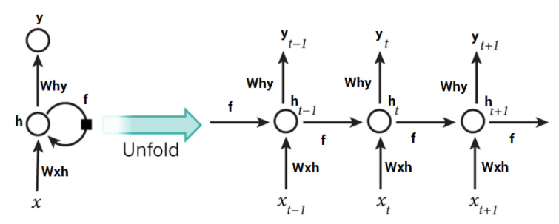
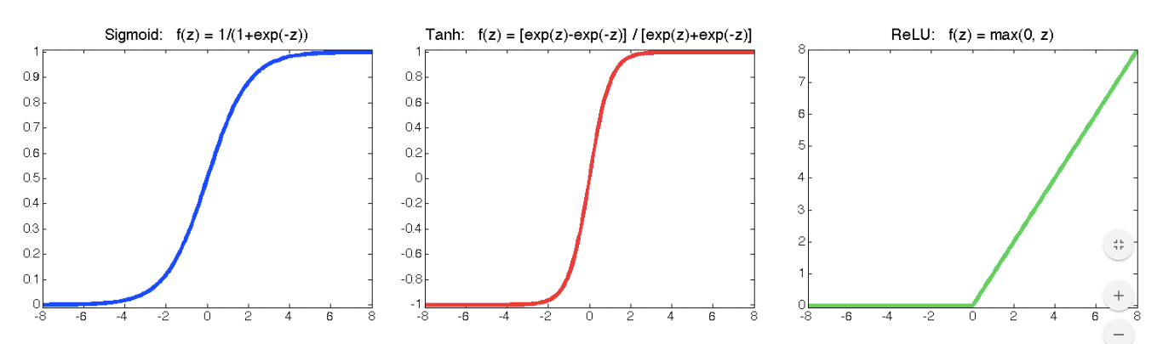
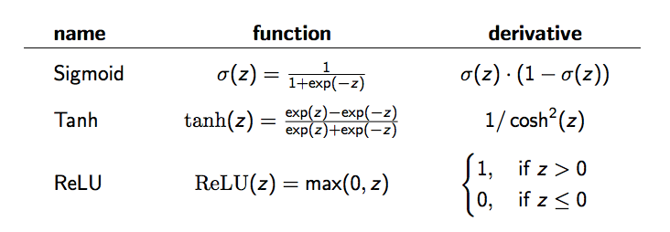
Example: Using tanh as Activation Function
+ bias )
(recall activation functions)
Sigmoid
Tanh
ReLU
https://www.analyticsvidhya.com/blog/2017/12/introduction-to-recurrent-neural-networks/

Slide 26
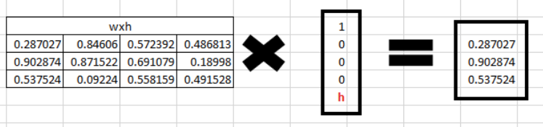
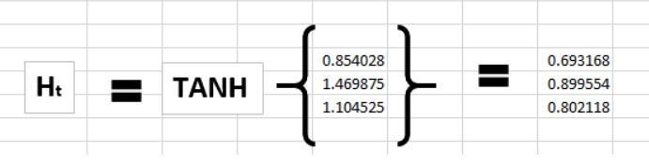
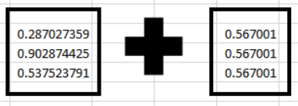
Example: Forward Pass (time step 1)
Initialize to random value: 0.427043
Initialize to random value: 0.567001
+ bias )
Initialize to 0
Input at next time step
https://www.analyticsvidhya.com/blog/2017/12/introduction-to-recurrent-neural-networks/

Slide 27
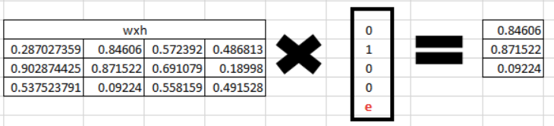
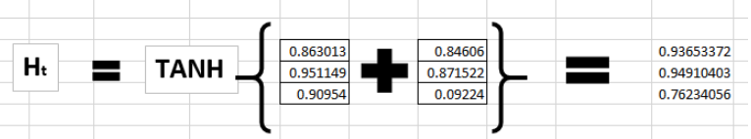
Example: Forward Pass (time step 2)
+ bias )
Output at previous time step
https://www.analyticsvidhya.com/blog/2017/12/introduction-to-recurrent-neural-networks/

Slide 28
Example: Forward Pass (and so on for remaining time steps…)
https://www.analyticsvidhya.com/blog/2017/12/introduction-to-recurrent-neural-networks/

Slide 29
Example: Prediction (Many-To-One)
https://www.analyticsvidhya.com/blog/2017/12/introduction-to-recurrent-neural-networks/

Slide 30
Example: Prediction (Many-To-Many)
https://www.analyticsvidhya.com/blog/2017/12/introduction-to-recurrent-neural-networks/

Slide 31
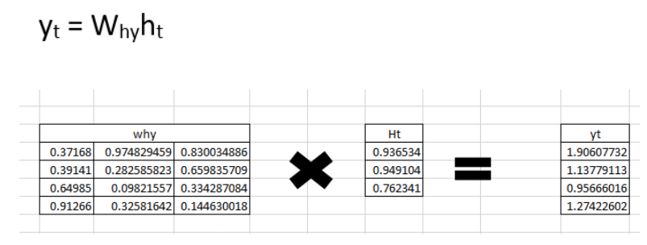
Example: Prediction for Time Step 2
https://www.analyticsvidhya.com/blog/2017/12/introduction-to-recurrent-neural-networks/

Slide 32
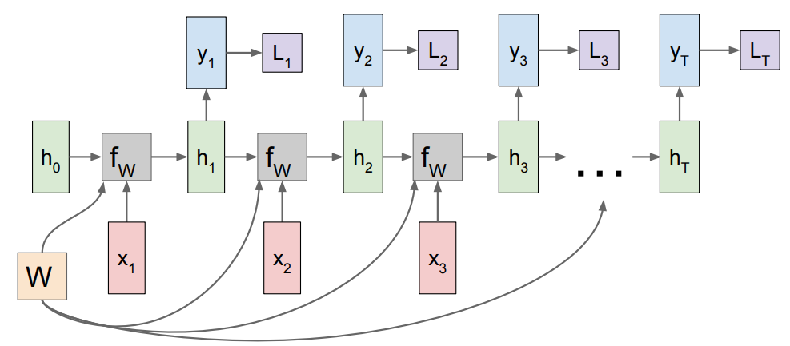
Example: Calculate Prediction Error
http://cs231n.stanford.edu/slides/2017/cs231n_2017_lecture10.pdf

Slide 33
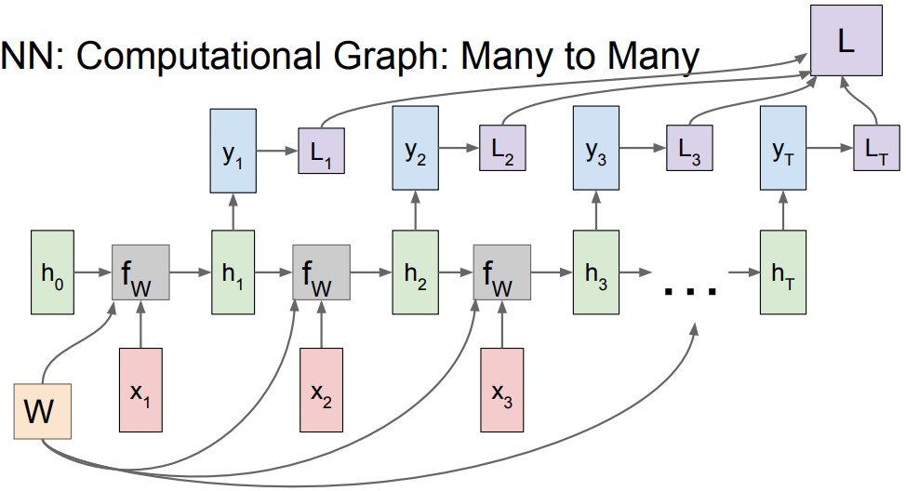
Example: Calculate Prediction Error
http://cs231n.stanford.edu/slides/2017/cs231n_2017_lecture10.pdf

Slide 34
Example: Gradient Descent
Compute gradients through usual backpropagation
Update shared weights
http://cs231n.stanford.edu/slides/2017/cs231n_2017_lecture10.pdf

Slide 35
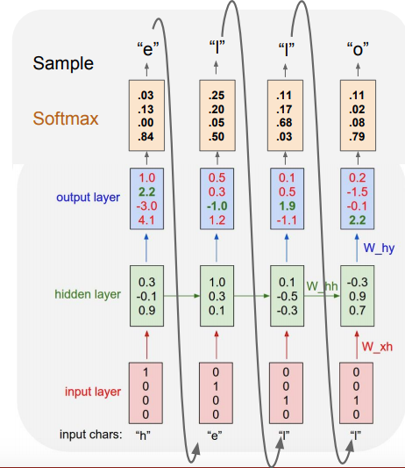
Example: Test Predictions
Which characters are predicted correctly?
Which characters are predicted incorrectly?
http://cs231n.stanford.edu/slides/2017/cs231n_2017_lecture10.pdf

Slide 36
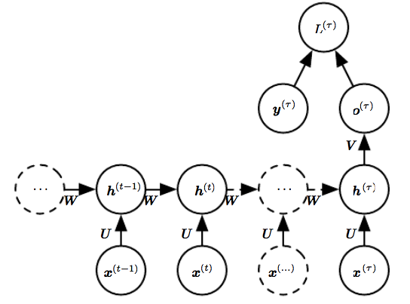
RNN: Example of Many-To-One Architecture
Slide Credit: Deep Learning, Ian Goodfellow, Yoshua Bengio, and Aaron Courville

Slide 37
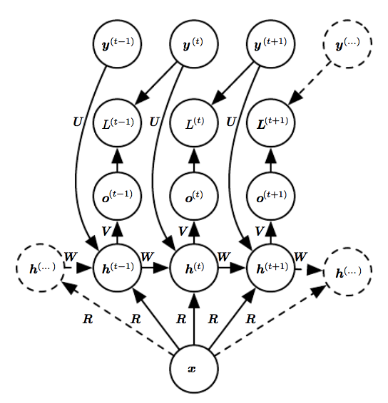
RNN: Example of One-To-Many Architecture
Slide Credit: Deep Learning, Ian Goodfellow, Yoshua Bengio, and Aaron Courville

Slide 38
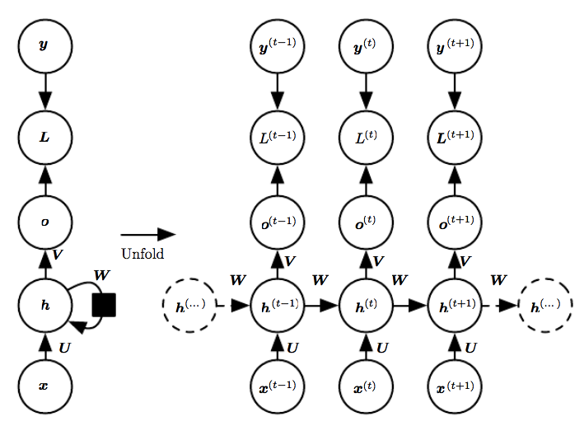
RNN: Example of Many-To-Many Architecture
Slide Credit: Deep Learning, Ian Goodfellow, Yoshua Bengio, and Aaron Courville

Slide 39
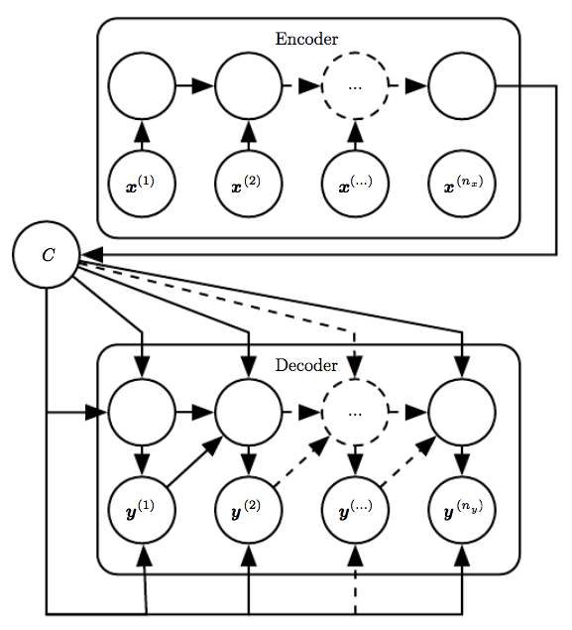
RNN: Example of Many-To-Many Architecture
Slide Credit: Deep Learning, Ian Goodfellow, Yoshua Bengio, and Aaron Courville

Slide 40
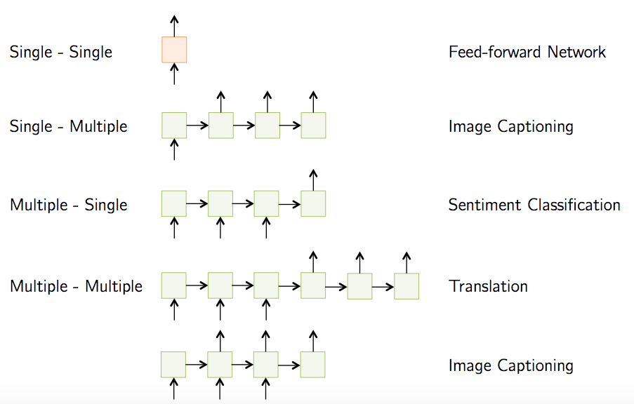
RNN Variants for Various Sequential Problems
http://slazebni.cs.illinois.edu/spring17/lec02_rnn.pdf

Slide 41
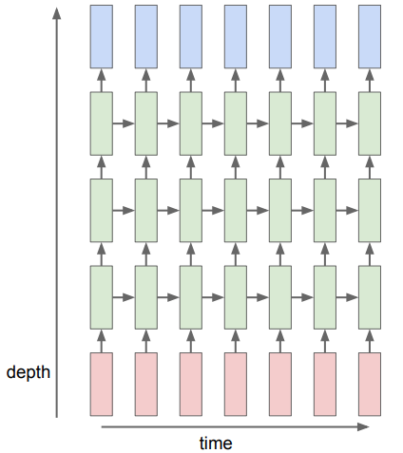
RNNs of Different Sizes
http://cs231n.stanford.edu/slides/2016/winter1516_lecture10.pdf

Slide 42
Today’s Topics
Machine Learning for Sequential Data
Recurrent Neural Networks (RNNs)
Vanishing/Exploding Gradients
Gated RNNs: LSTMs
Lab

Slide 43
In Practice, Do Not Use Vanilla RNN… Why?
Long-term dependencies; e.g.,
Vanishing gradient: a product of numbers less than 1 shrinks to zero
Exploding gradient: a product of numbers greater than 1 explodes to infinity
Hochreiter 1991
Razvan Pascanu, Tomas Mikolov, Yoshua Bengio; On the difficulty of training Recurrent Neural Networks; 2012
https://www.analyticsvidhya.com/blog/2017/12/introduction-to-recurrent-neural-networks/

Slide 44
Exploding Gradient Solution?
Truncated backpropagation through time (TBPTT): clip gradients above a given threshold

Slide 45
Vanishing Gradient Solution…
Many, but popular solution is modying RNN architecture

Slide 46
Today’s Topics
Machine Learning for Sequential Data
Recurrent Neural Networks (RNNs)
Vanishing/Exploding Gradients
Gated RNNs: LSTMs
Lab

Slide 47
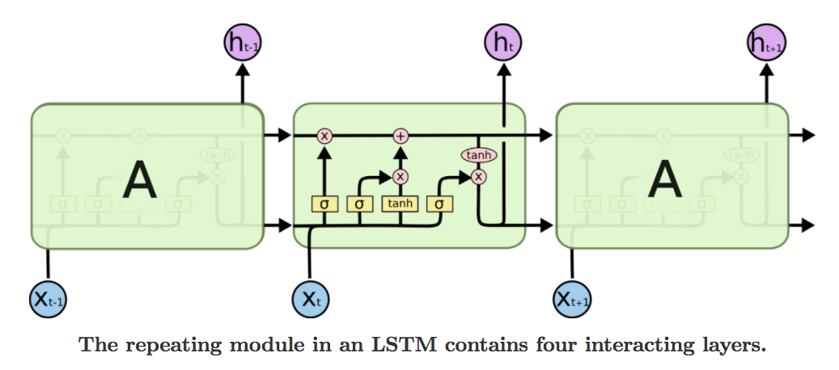
RNN: Long Short-Term Memory (LSTM)
Repeating module has a different structure in LSTM than RNN.
Instead of having a single neural network layer, there are four, interacting in a very special way.
https://colah.github.io/posts/2015-08-Understanding-LSTMs/

Slide 48
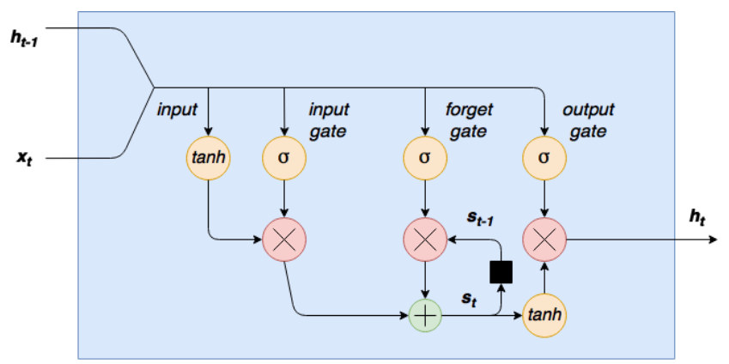
RNN: Long Short-Term Memory (LSTM)
http://cs231n.stanford.edu/slides/2017/cs231n_2017_lecture10.pdf
Slide Credit: http://adventuresinmachinelearning.com/recurrent-neural-networks-lstm-tutorial-tensorflow/

Slide 49
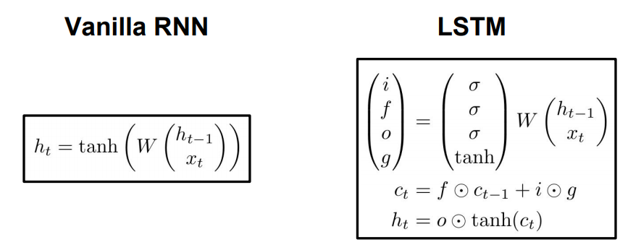
RNN: Long Short-Term Memory (LSTM)
http://cs231n.stanford.edu/slides/2017/cs231n_2017_lecture10.pdf
Slide Credit: http://adventuresinmachinelearning.com/recurrent-neural-networks-lstm-tutorial-tensorflow/

Slide 50
RNN: Long Short-Term Memory (LSTM)
S. Hochreiter and J. Schmidhuber; Long Short-Term Memory; 1997
Slide Credit: http://adventuresinmachinelearning.com/recurrent-neural-networks-lstm-tutorial-tensorflow/

Slide 51
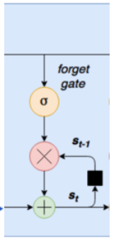
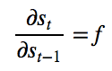
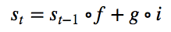
RNN: Long Short-Term Memory (LSTM)
Key ingredient: new variable s_{t} is inner state of the LSTM cell
Forget gate: multiplied by s_{t-1} to determine which previous states to remember (i.e. forget gate output near 1) and which to forget (i.e. forget gate output near 0).
e.g., learn who “she” refers to in the sentence “Clare took Helen to Paris and she was very grateful”
Goal: forget the subject “Clare” and replace with subject “Helen”.
By adding the forget-gate to the input, rather than multiplying, the issue of vanishing gradients is reduced.
Slide Credit: http://adventuresinmachinelearning.com/recurrent-neural-networks-lstm-tutorial-tensorflow/

Slide 52
Today’s Topics
Machine Learning for Sequential Data
Recurrent Neural Networks (RNNs)
Vanishing/Exploding Gradients
Gated RNNs: LSTMs
Lab

